Slide 1
Student Progression Tracking to Support Student Pathways and Increase Completion
Patrick Sanger Alvin Community College
psanger@alvincollege.edu

Slide 2
Who is Alvin Community College?
Alvin Community College is a medium sized HSI college just south of Houston
We have a Fall unduplicated enrollment of around 5,600
78% of our students are part-time
Student Information System: Ellucian Colleague
Data Warehouse: Zogotech
Analysis and Dashboarding: Tableau
Our IER office consists of 5 full-time staff – 2 data focused, 2 assessment based, and a Dean

Slide 3
Outcomes of This Session
Understand the challenges associated with tracking student progression in higher education and recognize the limitations of existing systems and staffing.
Explore the benefits of using data to support student pathways and increase program completion rates.
Gain insights into strategies like identifying alternate degree options and off-path courses .

Slide 4
Topics to be Covered
Brief overview of Guided Pathways
History of tracking student progression at Alvin Community College
Strategies that might be quick to implement:
Possible Completers
Near Completers
Off-Path

Slide 5
Guided Pathways – National and Texas
It is a student success framework to support colleges as they clarify paths for student end goals, help students choose and enter a pathway, help students stay on their pathway, and ensure students are learning.
There are 4 pillars used in Texas:
Mapping Pathways to Student End Goals
Helping Students Choose and Enter a Pathway
Keeping Students on Path
Ensuring Students are Learning

Slide 6
Guided Pathways – Keeping Student on Path
Pillar 3 of the Texas Pathways is about keeping students on their path.
How can we help to keep students on their path?
What can we do to make their path easier to follow?

Slide 7
Tracking Student Progression at ACC - Historical
Tracking students can be difficult given your resources, tools, and software.
Once we added a data warehouse, we started having a faster mechanism to track student progression. Before that, it was a manual process and typically done program by program.
We’ve been working with Zogotech to speed up the process of tracking students.

Slide 8
Strategies
We’re going to talk about three areas that might produce quick results and can be achievable with even limited resources.
Possible Completers
Near Completers
Off-Path

Slide 9
Possible Completers - Scheduling
Possible completers are students that are within a semester or two of completion. Essentially, within the school year.
Depending on your student makeup, if mostly PT, you will be looking for students with 12 or less credits to go – double that for FT.
What’s critical about these students are you can plan ahead and schedule classes they need and help to focus them on staying on the path.

Slide 10
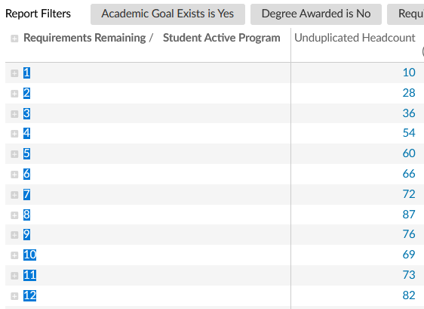
Possible Completers
Using our system, we can see that 713 of our 2024 Spring students are within 12 credits of finishing.

Slide 11
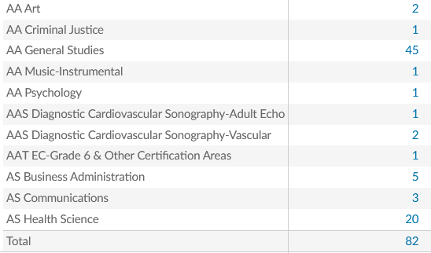
Possible Completers
Of the ones that have 12 credits remaining, we can drill in to see their majors, then classes they need.
This can help with scheduling to clear any barriers in their progression.

Slide 12
Possible Completers – Completers that haven’t been awarded
Another type of student is the one that may have completed but not been awarded for some reason.
Our system can run every student against every degree and then lists possible degrees that a student could be eligible for.
There are caveats on this and it requires human intervention, but we can typically find some that were overlooked, especially in certificates.

Slide 13
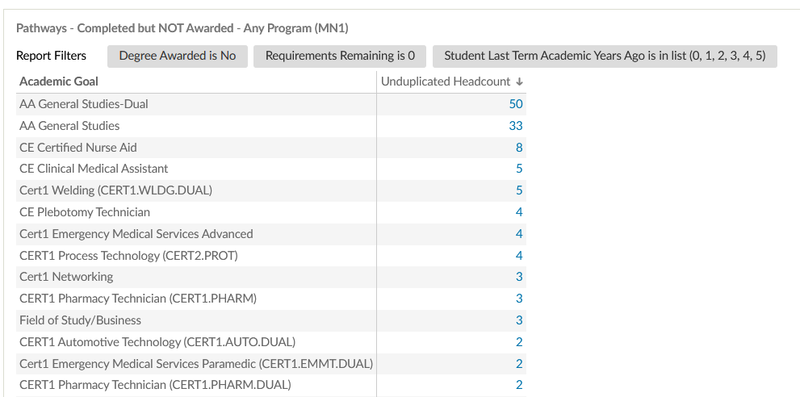
Possible Completers – Completed but not awarded?

Slide 14
Near Completers
Near completers are students that are within a few credits of completion. They should finish this semester.
What’s critical about these students is that you need to make sure they are staying on track. These students are the ones you want to watch carefully if you have early alerts or anything that can warn you of them slipping.

Slide 15
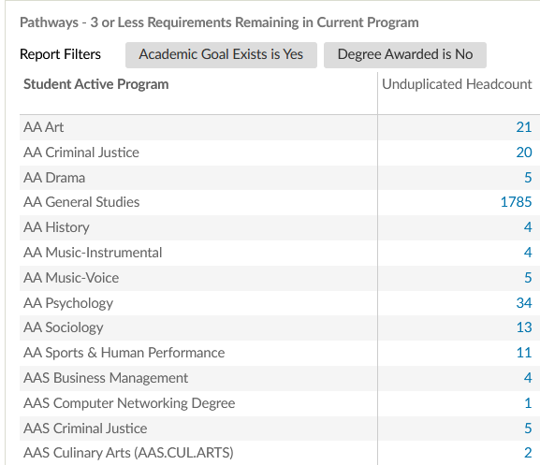
Near Completers
Our system has a “3 or less classes” category that allows us to look at the registered students and identify any that have 3 or less classes. We are predominantly PT so students typically take 2-3 classes in a semester.

Slide 16
Near Completers – Major Changes
Another area to watch for is students who may be able to graduate earlier under a different major.
In the next example, there is a Business Administration Major that is actually closer on their General Studies degree.

Slide 17
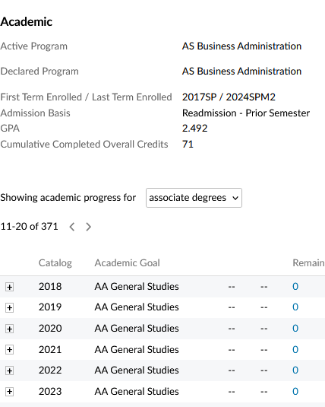
Possible Completers – Major Changes

Slide 18
Near Completers - Majors

Slide 19
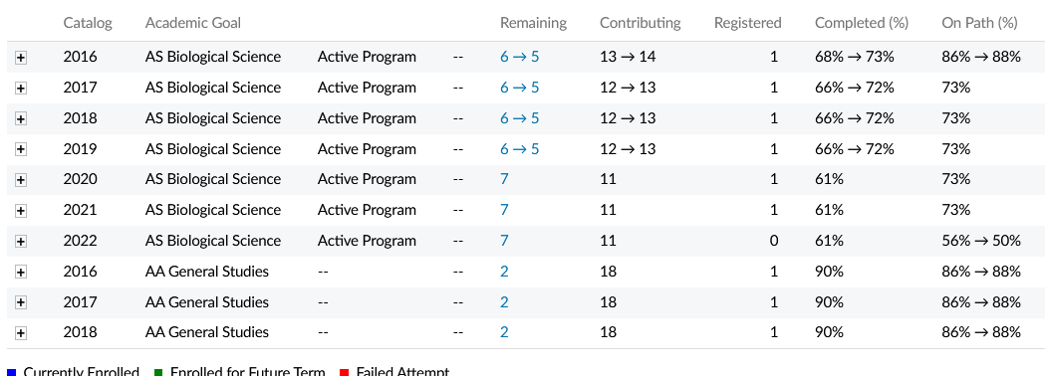
Near Completers - Majors
Or this Biological Sciences student who might want to switch?

Slide 20
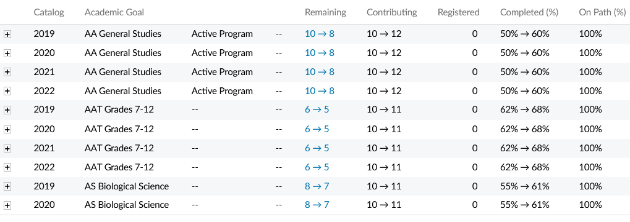
Near Completers - Majors
Or this General Studies student who is closer to 2 other degrees.

Slide 21
Near Completers - Catalogs
Our system compares the students against their catalog and the last 8. In this case you can see the student's catalog of 2019 is better for them than the new one. We often find the reverse as well, that a newer catalog benefits the student more.

Slide 22
Off Path
One of the biggest issues is students taking courses that are off path – or off degree.
Sometimes it is due to students making mistakes in their registration, especially with self registration, and taking courses that they do not need.
This can impact the time to completion, tuition costs of the student, or even their financial aid if they get too far off path.

Slide 23
Off Path
Our Spring 2024 enrollment has already identified some off-path students.
When drilling in, we find an Art Major taking an extra Art class

Slide 24
Off Path
We have also found students retaking Biology and Math.
When we identify these students during registration, we have time to contact the students and determine their intent.
Why are they in the class, was it on purpose, did they realize it was not needed, etc…

Slide 25
What’s Next?
As we are slowly developing these tools, we are working with our Advisors to intervene and discuss with students their progress and any of the elements we have found.
We have successfully identified and corrected numerous oversights that occur when processes are manual, such as some graduation and enrollment.

Slide 26
What’s Next?
We are working to create the early enrollment issues – such as Off-Path and Near Completers – into an “Extra early” early alert.
We are testing rolling out reports that will target any students that are closer to completion in a different degree to our Advisors, so they can discuss with our students their options.
Possible Completers course needs are being investigated for scheduling issues.

Slide 27
But I don’t have a Datawarehouse… what can I do?
Go after low hanging fruit and use data you can get.
Get a list of all majors with at least 50+ credits. Look to see what they need to complete.
Get a list of all students with 60-70 credits. Are they complete and don’t know it?
Look for any Technical majors with 50 credits that are in classes that might not be in their major.
Look at any degrees that have certs embedded. Did everyone who started within a year get awarded?
Look for any oddities – did a whole class get Incompletes? (true story) Did that delay their graduation?

Slide 28
Discussion and Questions
Thank you for being here and listening to some of the strategies that might produce quick results and can be achievable with even limited resources.
Does anyone have any questions?
Contact me at psanger@alvincollege.edu
Notes:
Discussion of Results and possible procedures to address findings (10 minutes)
What’s Next? (5 minutes)
Q&A (15 minutes)

